Slide 1
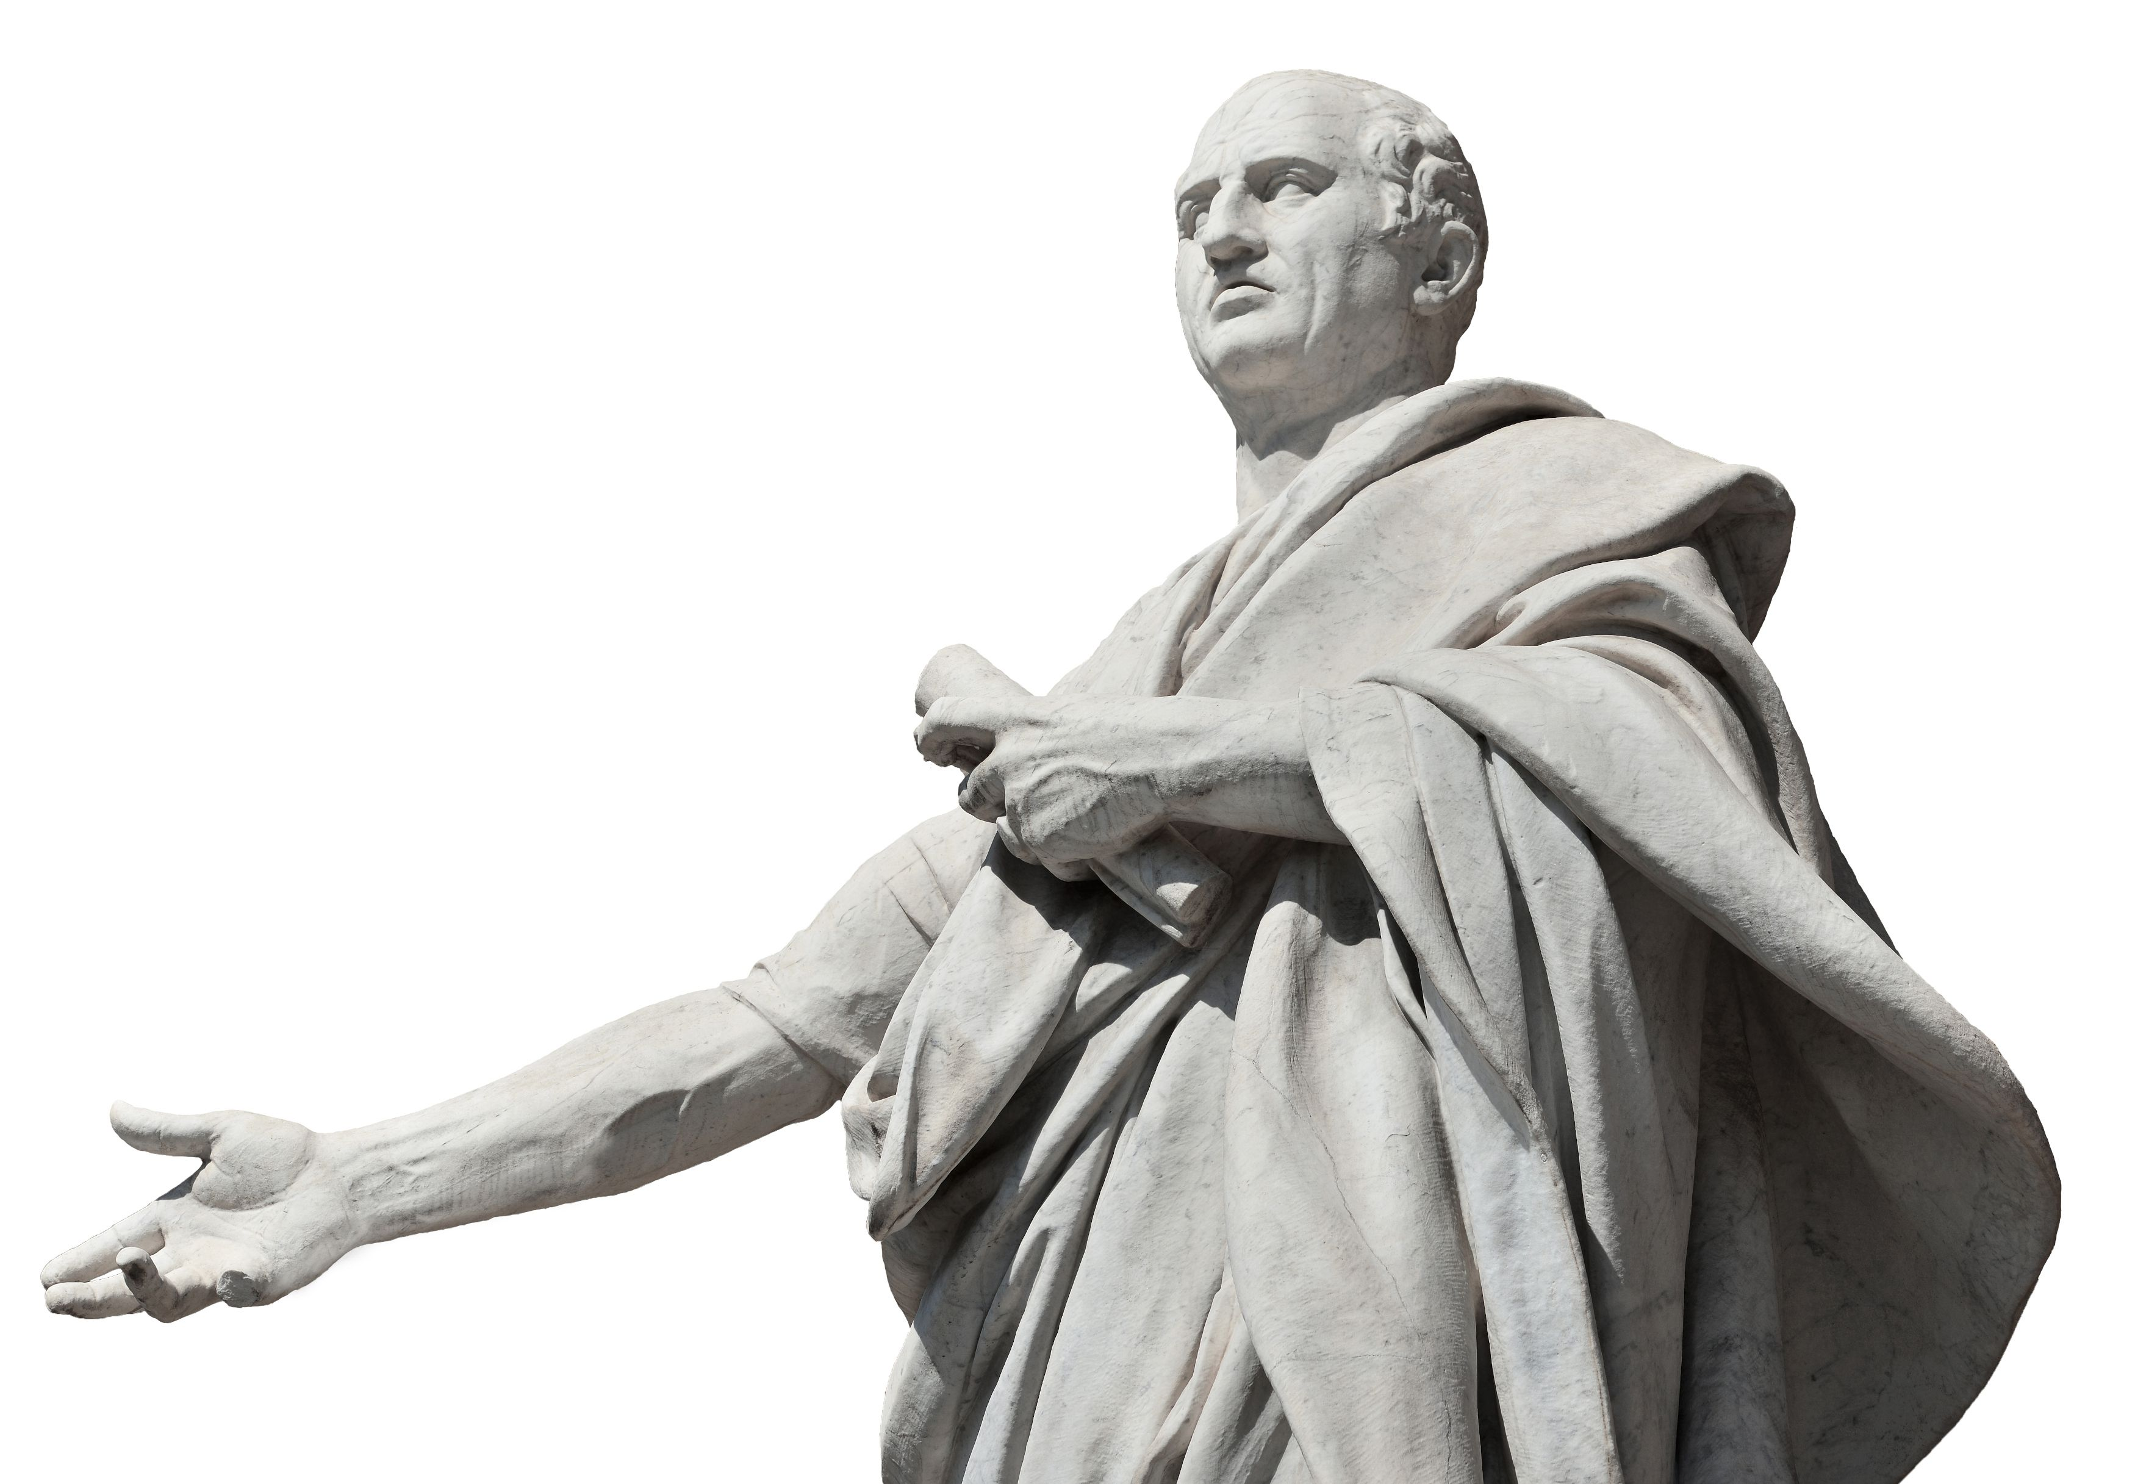
DE OFFICIIS MARCVS TVLLIVS CICERON (CICERO)
Project by Daniel Girvitz, W2022

Slide 2

Introduction
University major: Mathematics, formerly electrical engineering
Why I study Latin? The reason I tell people or the real reason?
My attraction to Cicero: I’ve always been attracted to the ostensibly best things in life. As the “Greatest Roman”, this should come as no surprise. My interest in De Officiis stems from a desire to appreciate the noble morals of antiquity, and the sort of reasoning a man should employ today.

Slide 3
Cicero
Roman lawyer, statesman, philosopher, etc., etc., who eventually became Consul of the Roman Republic in 63 BC
Acquired notability in the Roman courts
Involvement in Roman politics oversaw a complete restructuring of Roman society
After Caesar came to power, Cicero retired from politics
Introduced Greek philosophy to Ancient Rome and consequently Latin readers

Slide 4
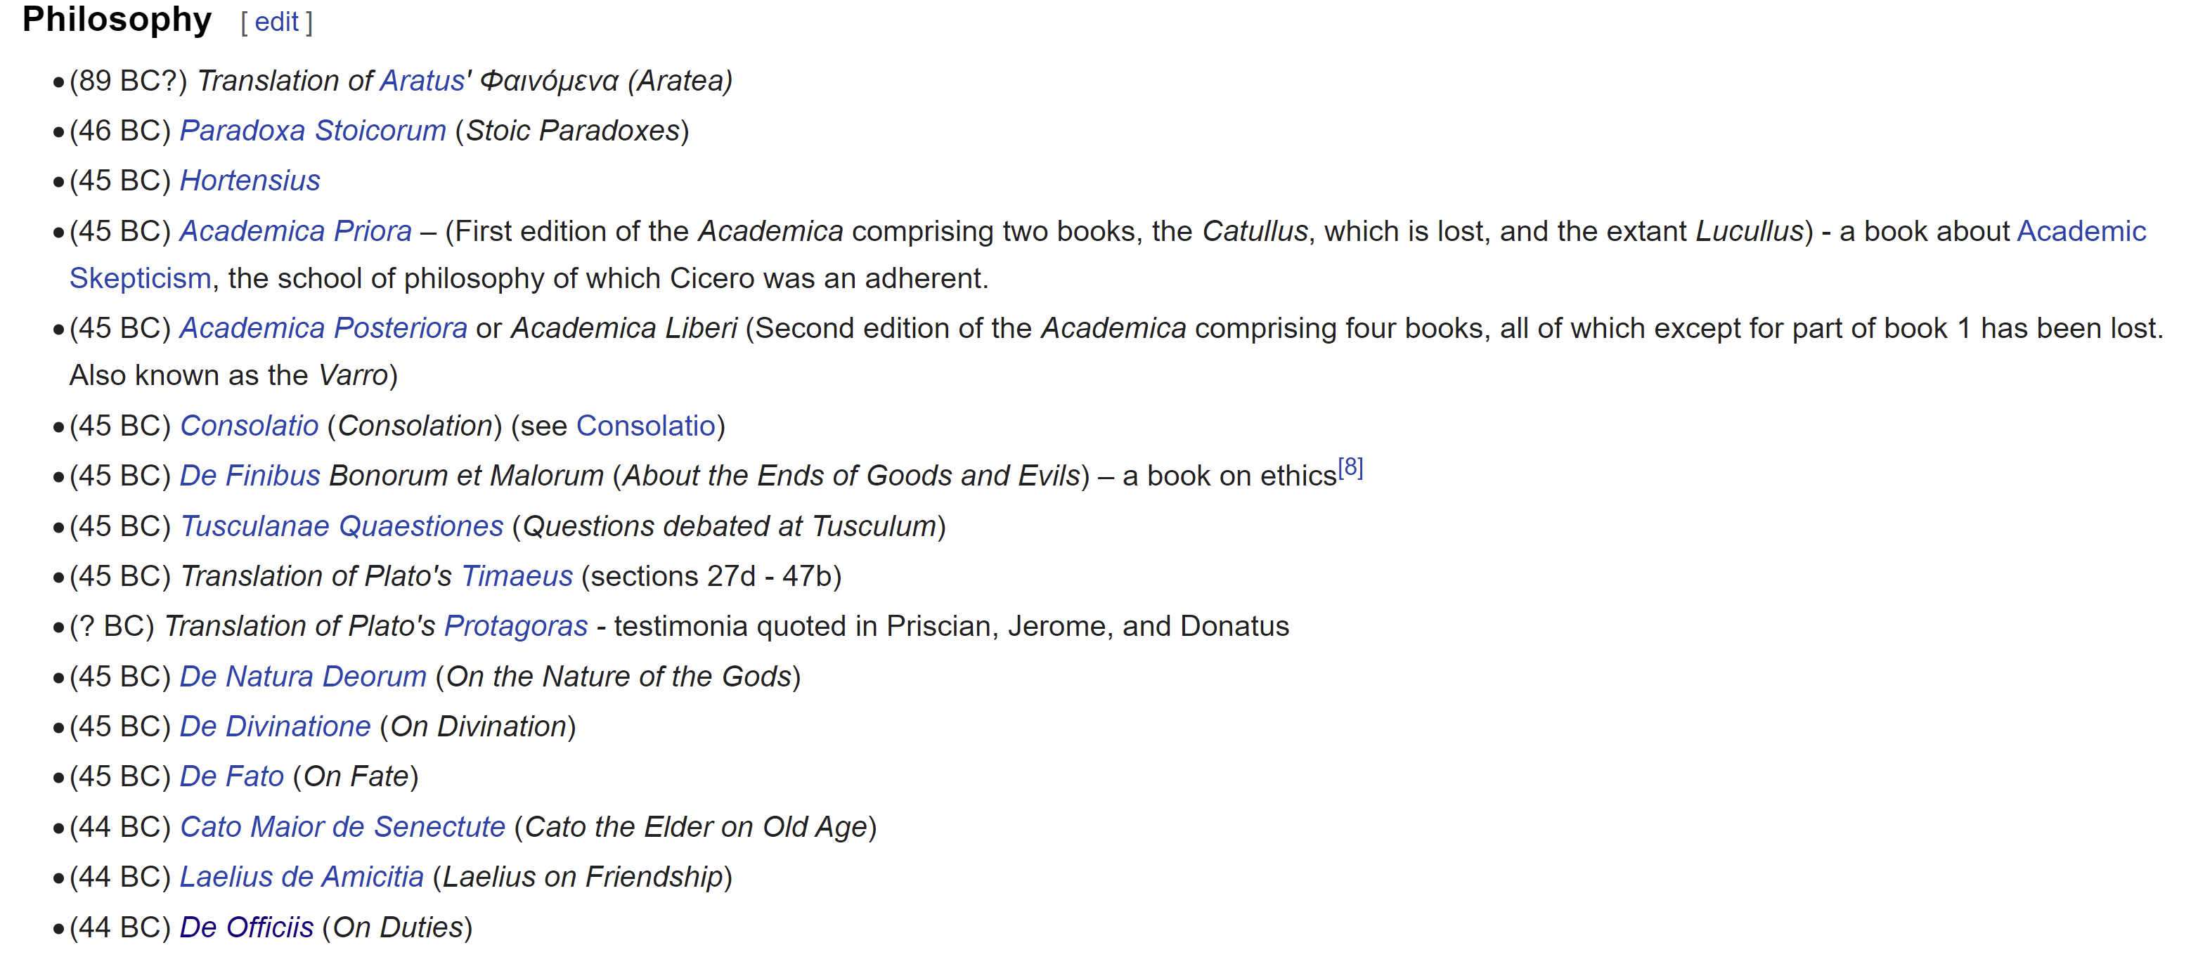
Notes:
Writings of Cicero - Wikipedia

Slide 5
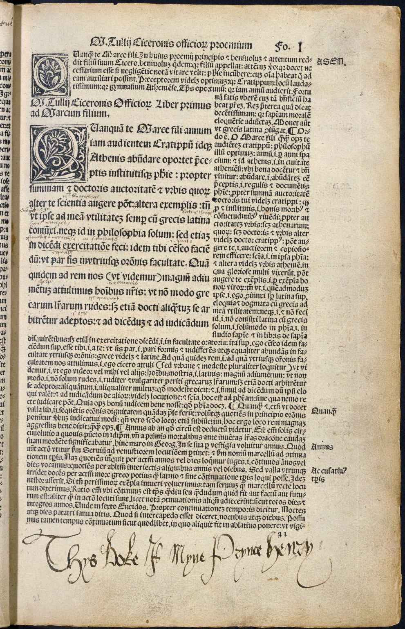
De Officiis
was the second book printed in Europe, after the Gutenberg Bible
was the third book to be printed—third only to the Gutenberg Bible and Donatus's "Ars Minor", which was the first printed book
In the 17th century it was a standard text at English schools (Westminster and Eton) and universities (Cambridge and Oxford)
Voltaire said of De Officiis "No one will ever write anything more wise”
Frederick the Great has called it “the best work on morals that has been or can be written”
Cicero himself considered it to be his masterpiece
Henry VIII's childhood copy of De Officiis, bearing the inscription "Thys boke is myne" in his hand, from the collection of the Folger Shakespeare Library.

Slide 6
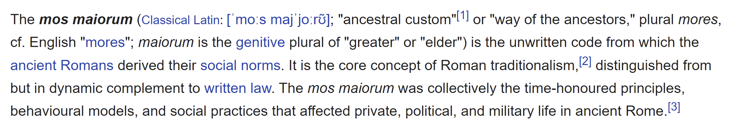
Philosophy and morals
The Ancient Greeks concerned themselves with all kinds of philosophy, but more so in the abstract: Aristotle’s Metaphysics, Plato’s …
Being more practical, the Romans considered ethics to be the only important branch of philosophy (φιλοσοφία, philosophia, 'love of wisdom’)
The word “morals” in Latin is “mos, mores”
Not only translating to morals and principles (in the plural “mores”)
But also to behaviour, conduct
Custom, habit (see mos maiorum)

Slide 8
Now for the contents
“De Officiis (On Duties or On Obligations) is a 44 BC treatise by Marcus Tullius Cicero divided into three books, in which Cicero expounds his conception of the best way to live, behave, and observe moral obligations. The work discusses what is honorable (Book I), what is to one's advantage (Book II), and what to do when the honorable and private gain apparently conflict (Book III). For the first two books Cicero was dependent on the Stoic philosopher Panaetius, but wrote more independently for the third book.” De Officiis - Wikipedia
Notes:
I took this excerpt from Wikipedia as I have not yet finished reading it myself.

Slide 9
What I think about it?
Great advice from one of the greatest men to live on this planet…
I’ll tell you more once I finish reading it.

Slide 10
Paragraph 13 - Search after truth
The search for truth is particular to man
And so when we are free from unavoidable labours ie work
We wish to see, hear, learn things which are occult and/or admirable
From this, what is true, simple, and sincere, is understood to be the most suitable of the nature of man
Ex quo intellegitur, quod verum, simplex, sincerumque sit, id esse naturae hominis aptissimum
sit -> 3rd person, sing, present subjunctive of sum, esse, fui, futurus
Subjunctive is often applied to indicate uncertainty, a sign of refinement
id intellegitur esse aptissimum naturae hominis -> accusative-infinitive construction
futurus – future active participle – sum, esse has no 4th principle part

Slide 11
Paragraph 13 cont.
Huic veri videndi cupiditati adiuncta est appetitio quaedam principatus
So that a mind well-moulded by nature would would want to obey nobody
ut nemini parere animus bene informatus a natura velit
ut velit -> subjunctive
parere nemini -> to obey nobody (pareo, parere takes a dative object)
bene informatus a natura -> passive with ablative of agent
Unless he teach good conduct, justice, and law
nisi praecipienti aut docenti aut utilitatis causa iuste et legitime imperanti
From this emerges greatness of the soul and contempt of all human things

Slide 12
Paragraph 14
Man is the only animal who has a feeling for reason and order
Consequently, no other animal has a feeling for beauty, excellence, and harmony
Similarly, nature and reason transfer from the eyes to the soul beauty, constancy, and order
So that disgracefulness and effeminacy are to be avoided
So that in all & thought & deed licentiousness is avoided too

Slide 13



Paragraph 14 cont
Quibus ex rebus conflatur et efficitur id,
From these things it [moral goodness] is forged (conflo, conflare)
quod quaerimus,
that WHICH we ask
honestum, quod etiamsi nobilitatum non sit,
even if it not be considered noble
tamen honestum sit,
it is nonetheless good
quodque vere dicimus,
and we truly say
etiamsi a nullo laudetur,
even if it be praised by nobody
natura esse laudabile.
nature praises it
natura -> ablative of agent
dicimus [id] esse laudabile -> acc-inf

Slide 14
The Latin text
13 In primisque hominis est propria veri inquisitio atque investigatio. Itaque cum sumus necessariis negotiis curisque vacui, tum avemus aliquid videre, audire, addiscere cognitionemque rerum aut occultarum aut admirabilium ad beate vivendum necessariam ducimus. Ex quo intellegitur, quod verum, simplex sincerumque sit, id esse naturae hominis aptissimum. Huic veri videndi cupiditati adiuncta est appetitio quaedam principatus, ut nemini parere animus bene informatus a natura velit nisi praecipienti aut docenti aut utilitatis causa iuste et legitime imperanti; ex quo magnitudo animi existit humanarumque rerum contemptio.
14 Nec vero illa parva vis naturae est rationisque, quod unum hoc animal sentit, quid sit ordo, quid sit, quod deceat, in factis dictisque qui modus. Itaque eorum ipsorum, quae aspectu sentiuntur, nullum aliud animal pulchritudinem, venustatem, convenientiam partium sentit; quam similitudinem natura ratioque ab oculis ad animum transferens multo etiam magis pulchritudinem, constantiam, ordinem in consiliis factisque conservandam[15] putat cavetque, ne quid indecore effeminateve faciat, tum in omnibus et opinionibus et factis ne quid libidinose aut faciat aut cogitet.
Quibus ex rebus conflatur et efficitur id, quod quaerimus, honestum, quod etiamsi nobilitatum non sit, tamen honestum sit, quodque vere dicimus, etiamsi a nullo laudetur, natura esse laudabile.

Slide 15
English translation
13 Above all, the search after truth and its eager pursuit are peculiar to man. And so, when we have leisure from the demands of business cares, we are eager to see, to hear, to learn something new, and we esteem a desire to know the secrets or wonders of creation as indispensable to a happy life. Thus we come to understand that what is true, simple, and genuine appeals most strongly to a man's nature. To this passion for discovering truth there is added a hungering, as it were, for independence, so that a mind well-moulded by Nature is unwilling to be subject to anybody save one who gives rules of conduct or is a teacher of truth or who, for the general good, rules according to justice and law. From this attitude come greatness of soul and a sense of superiority to worldly conditions.
The Project Gutenberg eBook of De Officiis, by Cicero

Slide 16
English translation cont.
14 And it is no mean manifestation of Nature and Reason that man is the only animal that has a feeling for order, for propriety, for moderation in word and deed. And so no other animal has a sense of beauty, loveliness, harmony in the visible world; and Nature and Reason, extending the analogy of this from the world of sense to the world of spirit, find that beauty, consistency, order are far more to be maintained in thought and deed, and the same Nature and Reason are careful to do nothing in an improper or unmanly fashion, and in every thought and deed to do or think nothing capriciously.
It is from these elements that is forged and fashioned that moral goodness which is the subject of this inquiry—something that, even though it be not generally ennobled, is still worthy of all honour; and by its own nature, we correctly maintain, it merits praise, even though it be praised by none.
The Project Gutenberg eBook of De Officiis, by Cicero
Thank you!

Slide 17
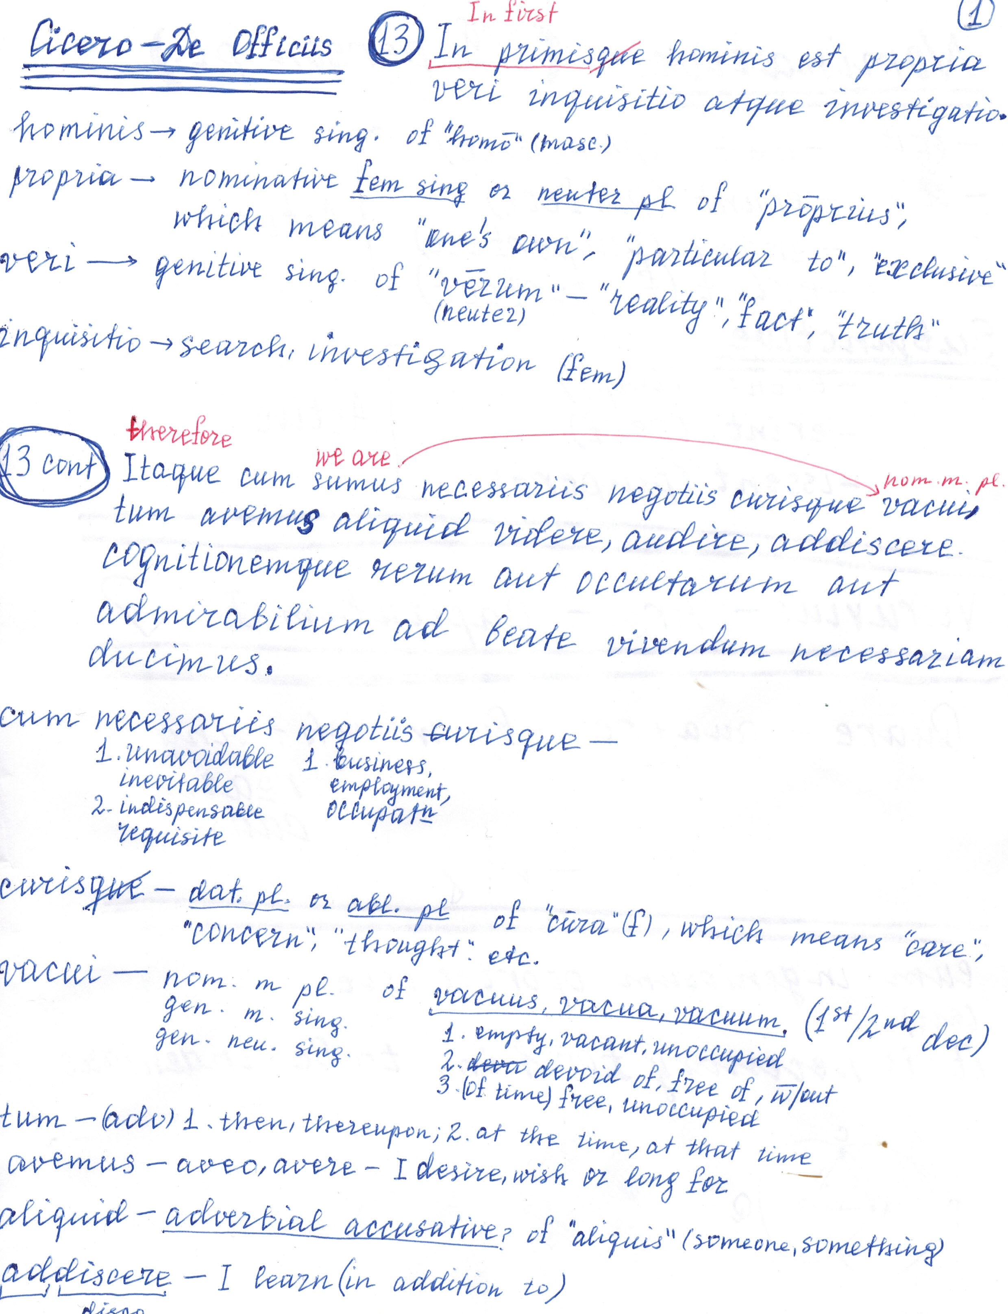

Slide 18
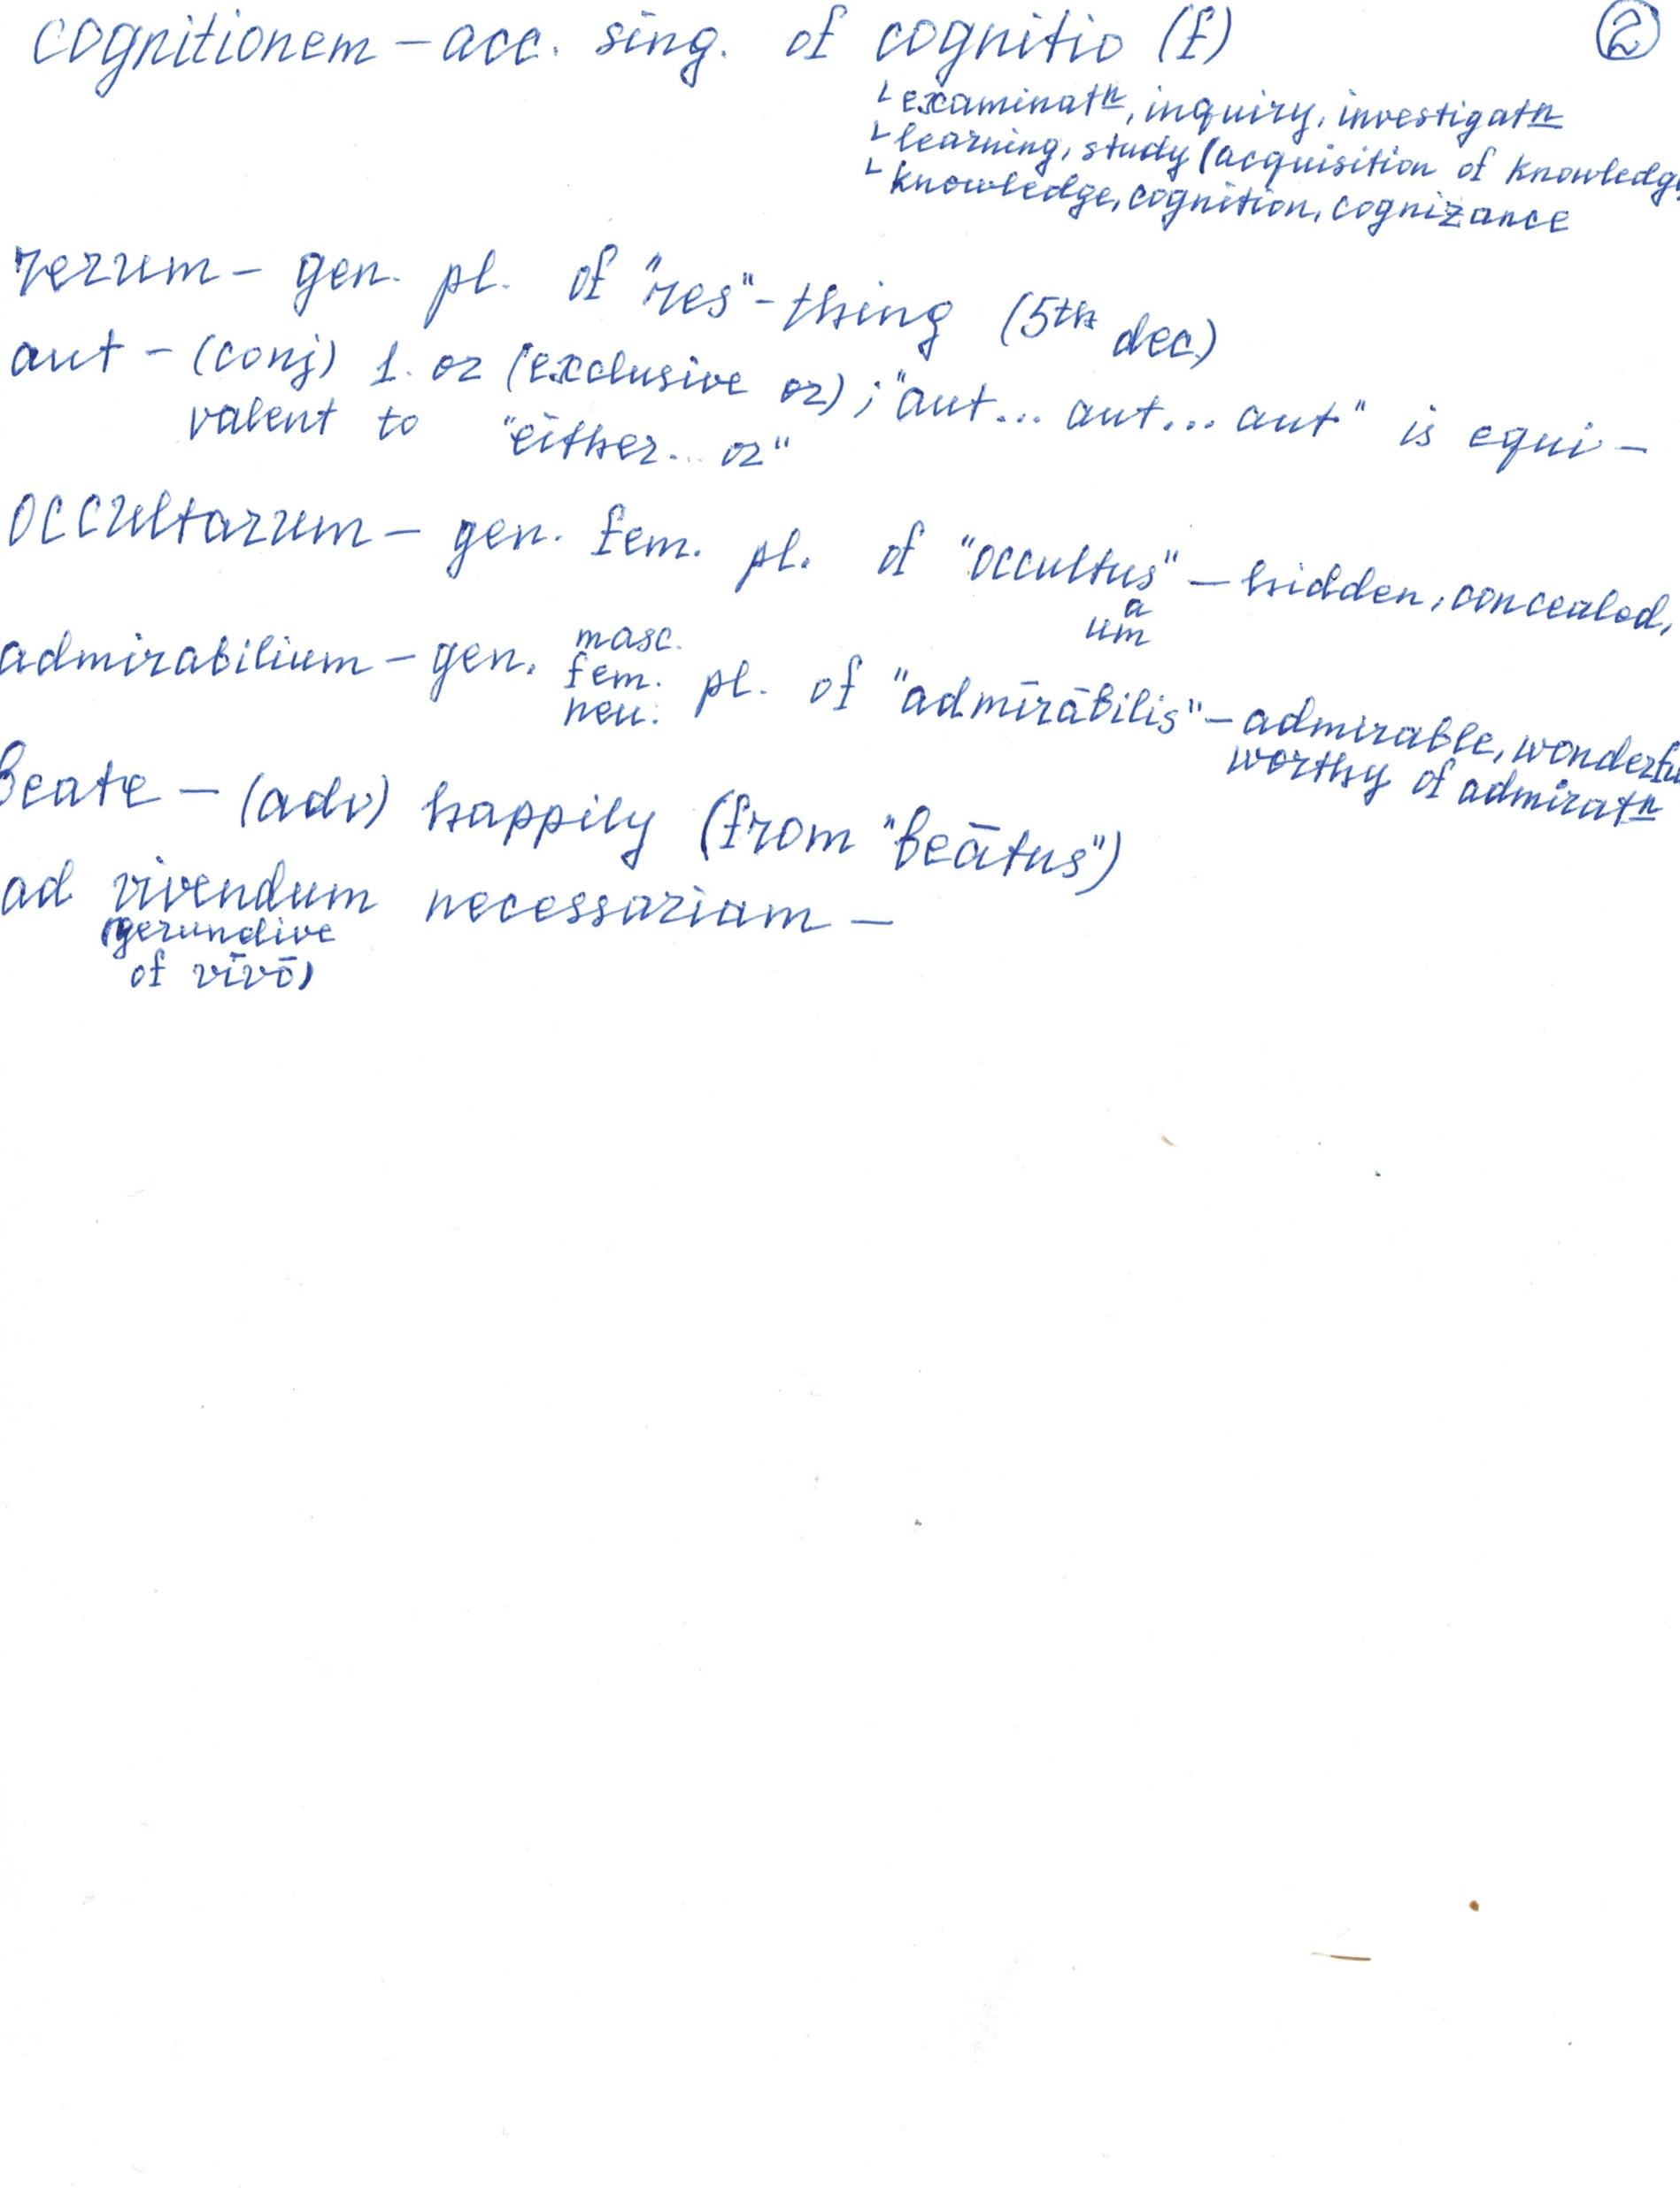

Slide 19
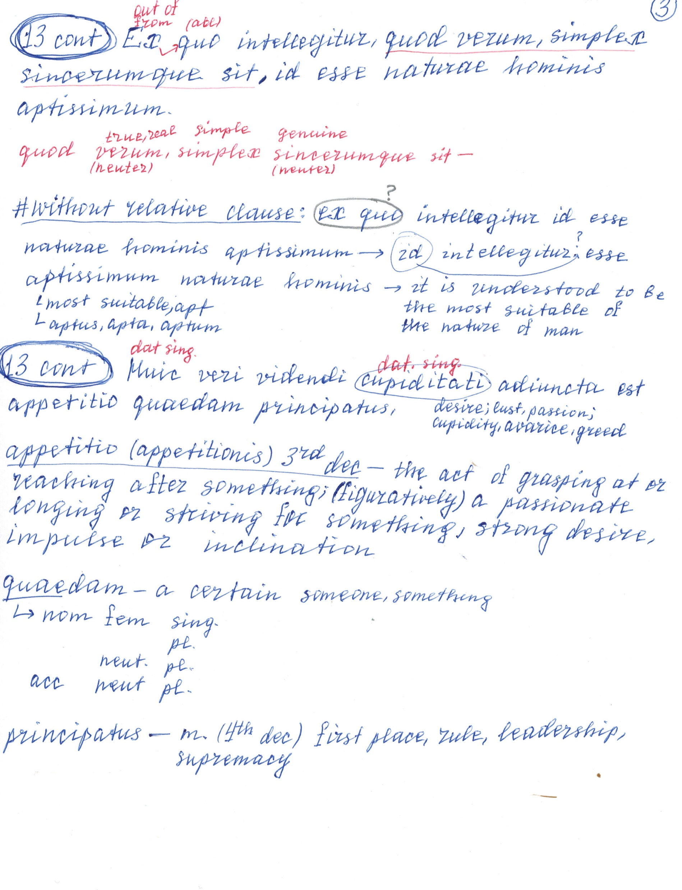

Slide 20
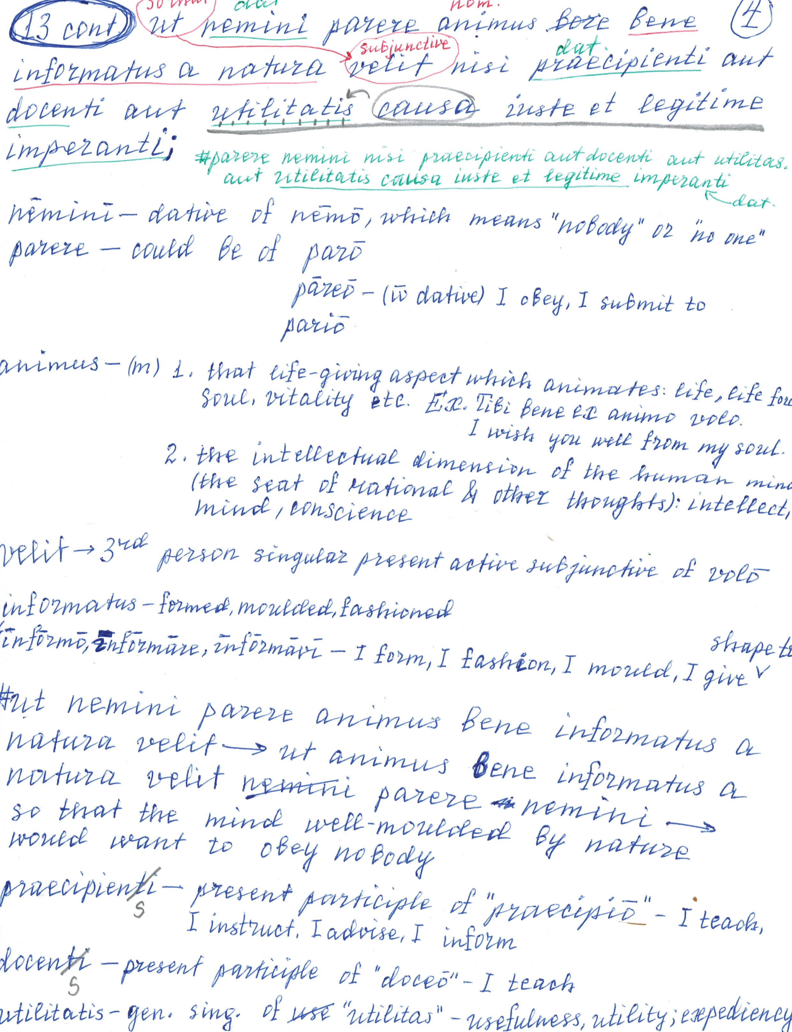

Slide 21
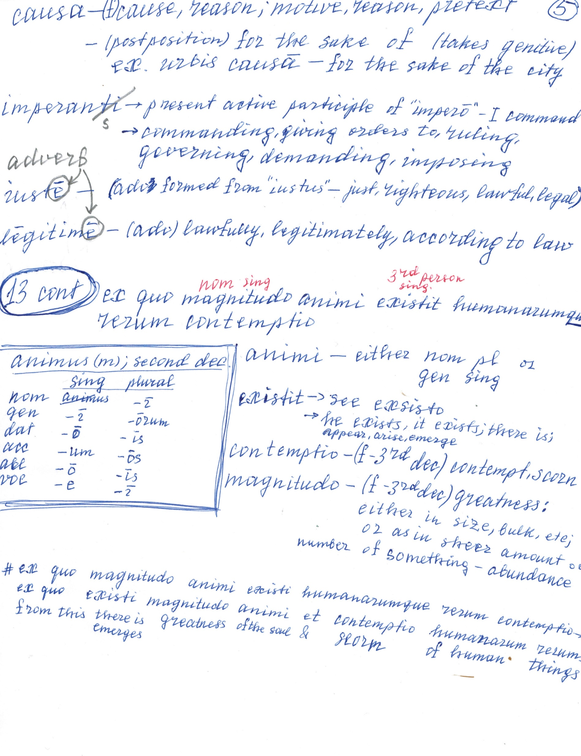

Slide 22
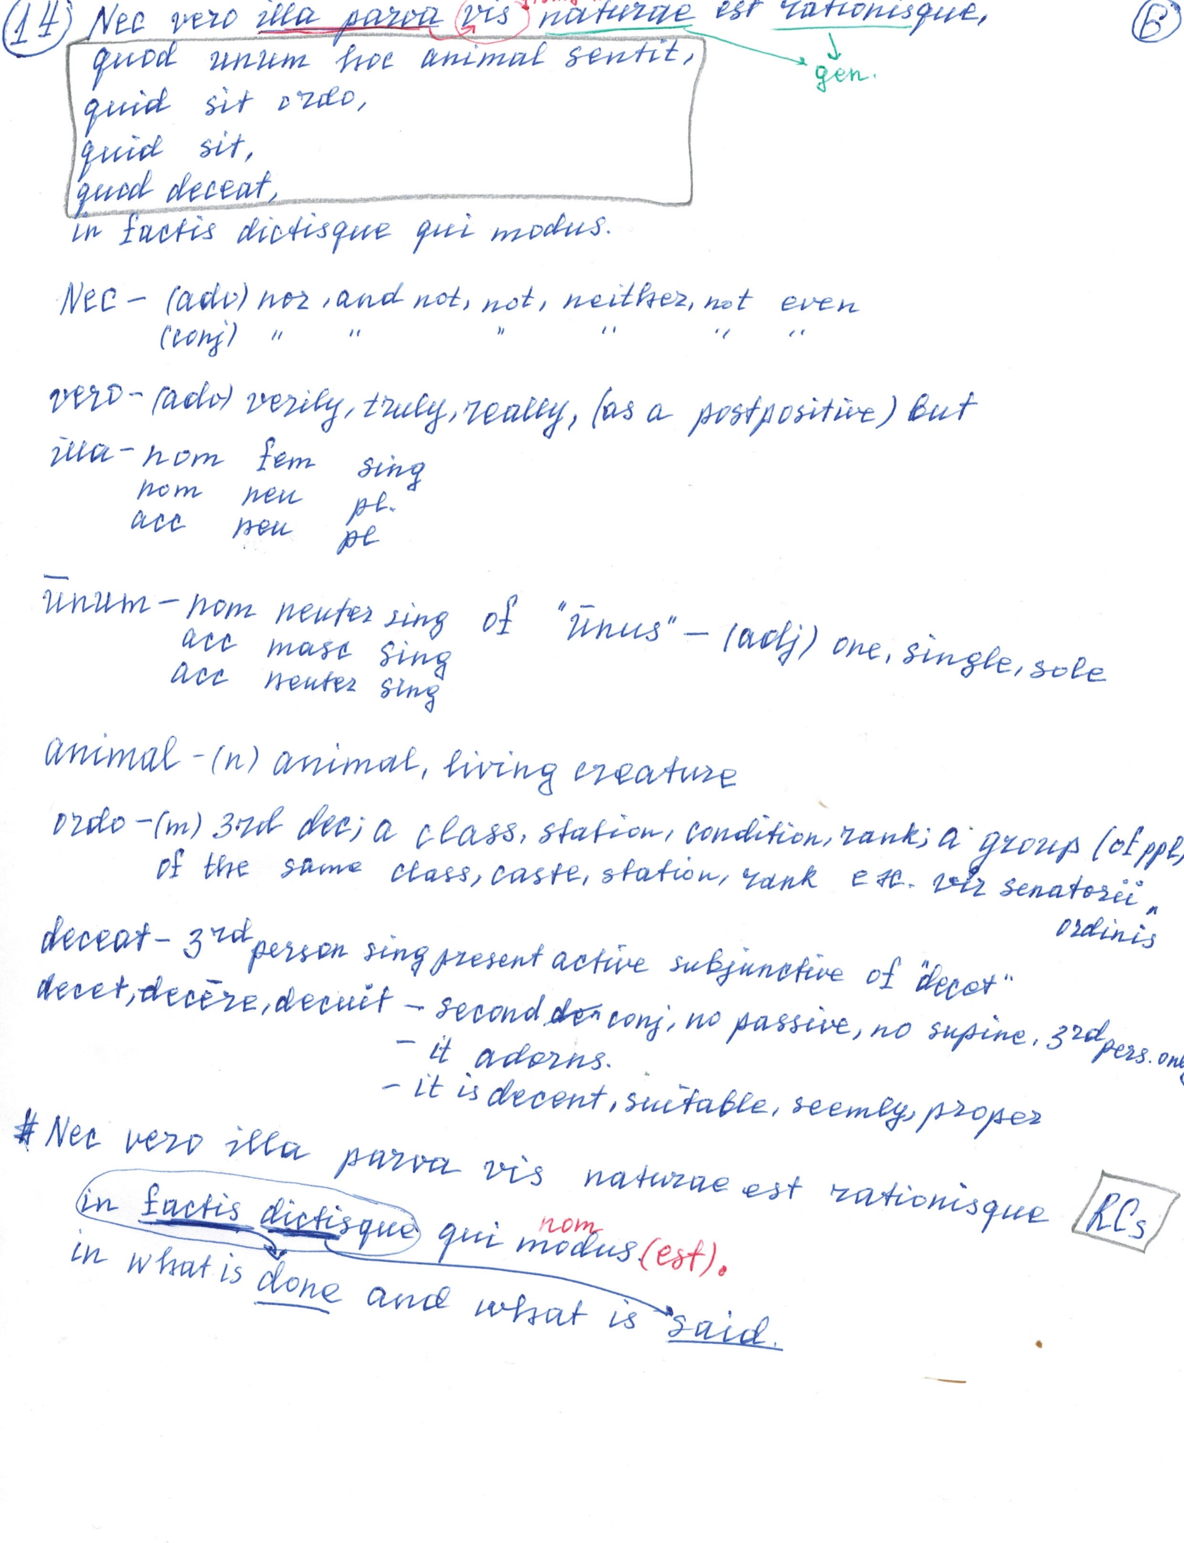

Slide 23
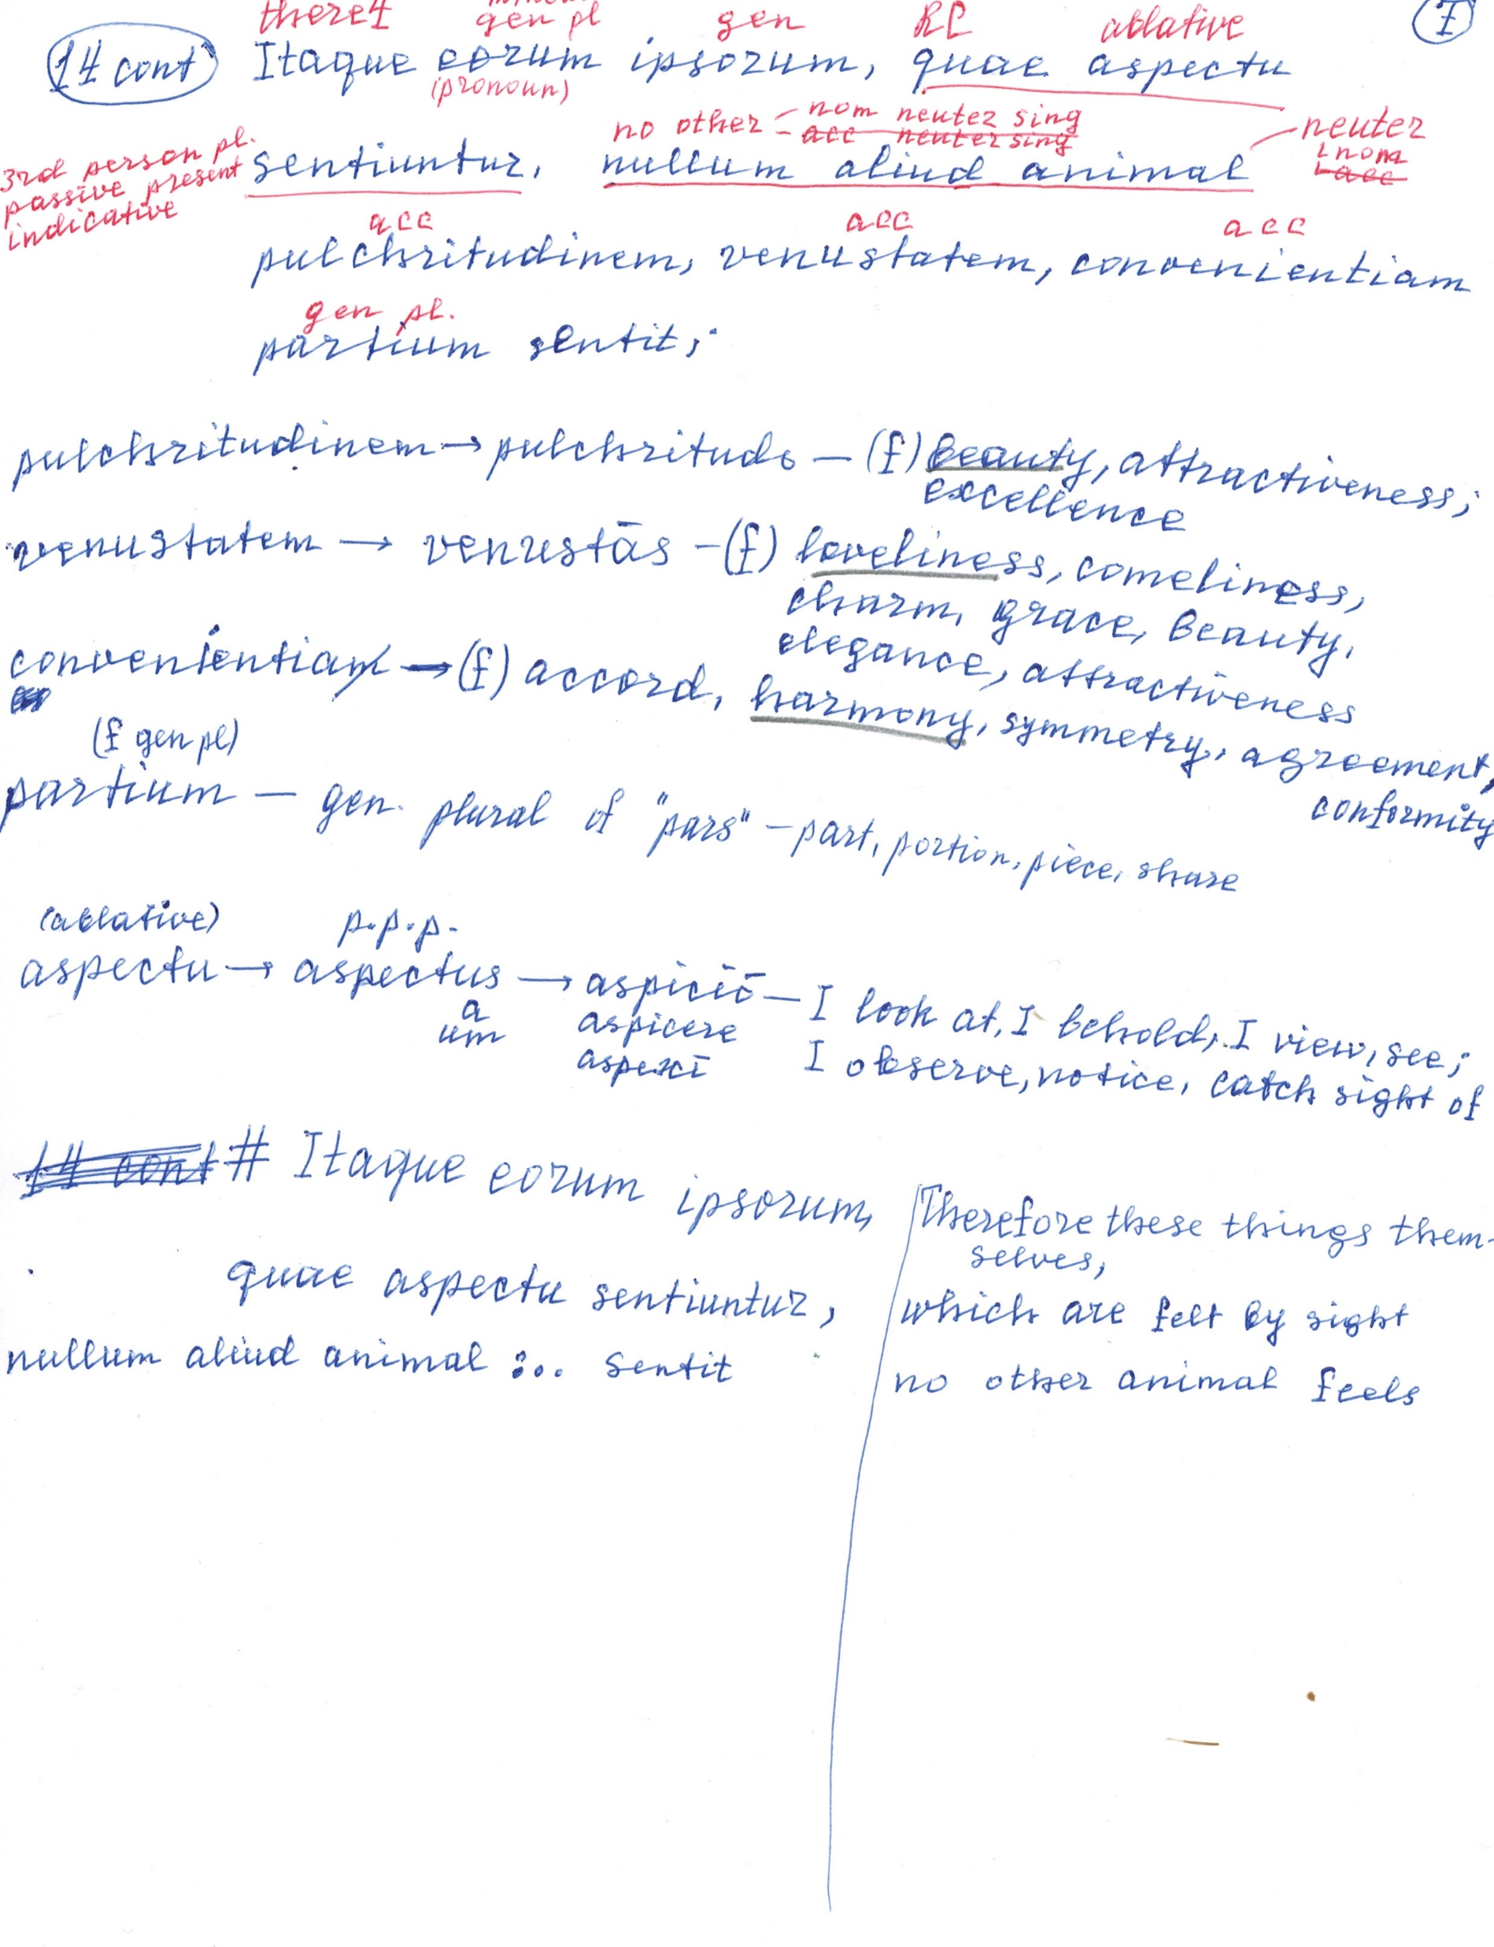

Slide 24
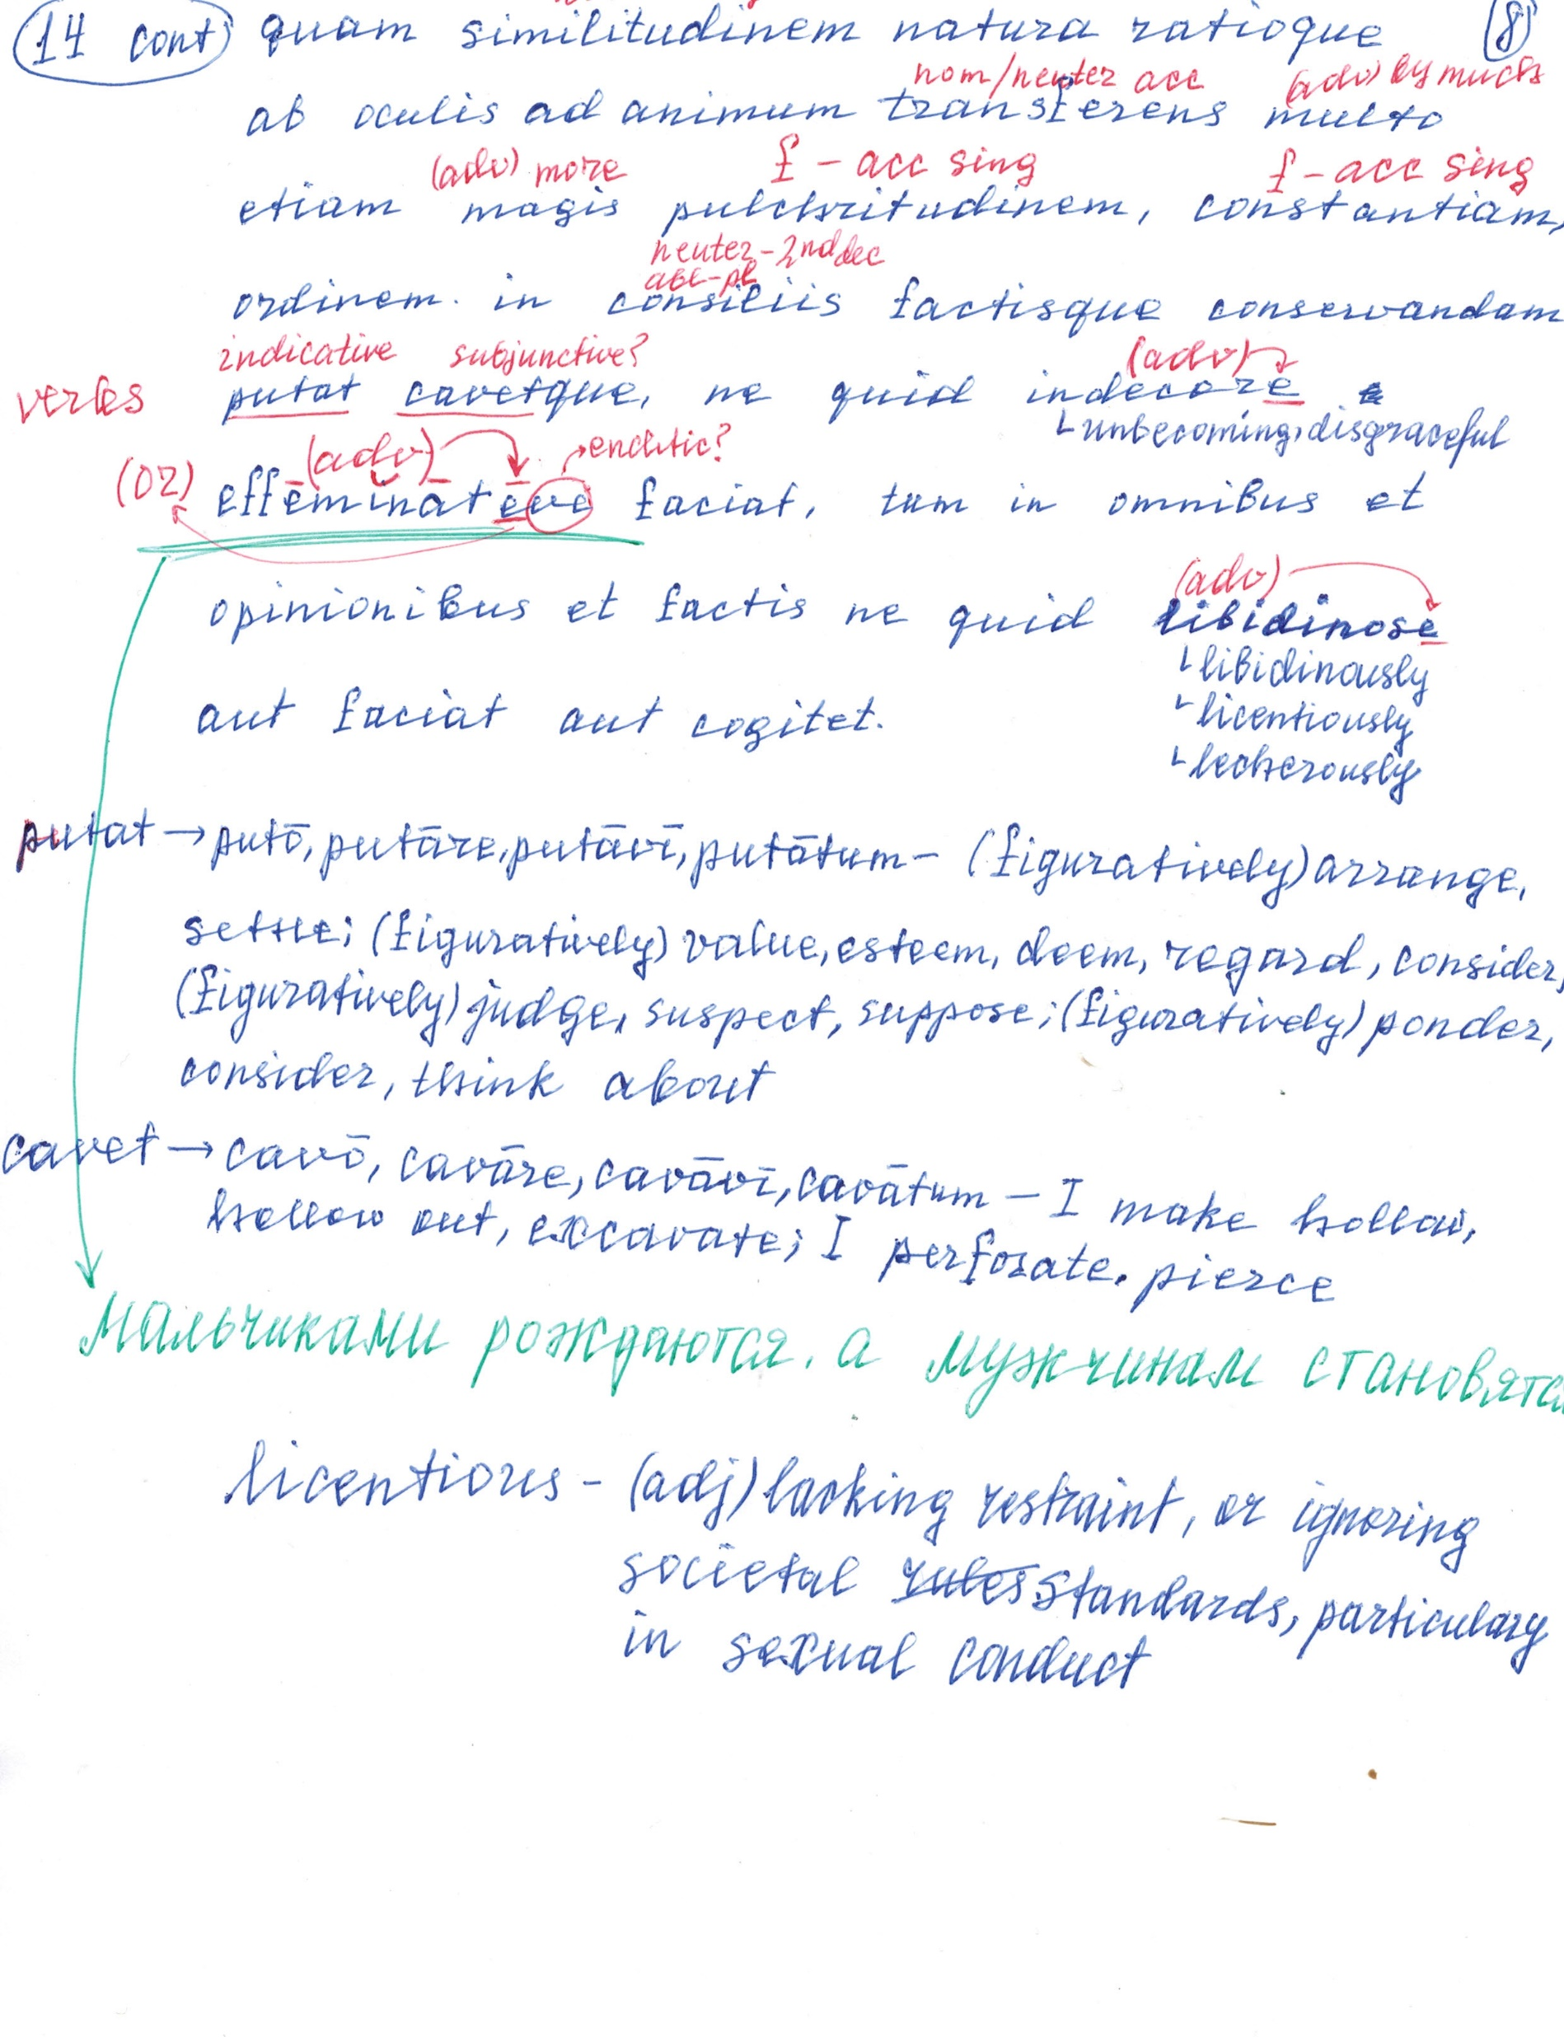

Slide 25
